Slide 1
Practical guide for using Azure Security Center to protect hybrid cloud environment
Name
Title

Slide 2
Intro

Slide 3

Azure Security Center
Microsoft cloud workload protection platform to address the unique security requirements of Azure workloads and data center architectures that span on-premises and public cloud environments. Provide a secure migration path to Azure for enterprises both exploring Azure or going “all in”.

Slide 4
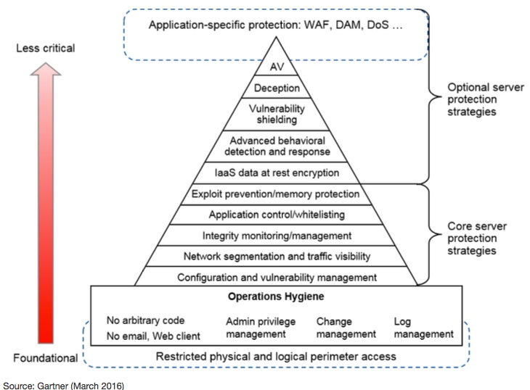
What is CWPP?
Per Gartner
Agent-based
Server workload protection
Hybrid data center architectures
Physical and virtual machines (VMs)
Multiple public cloud infrastructure as a service
(IaaS)
Ideally, container-based too

Slide 5

Improving security across hybrid cloud environments
Azure Security Center
Strengthen security posture
Protect against threats
Get secure faster

Slide 6
Securing VMs/Compute workloads

Slide 7
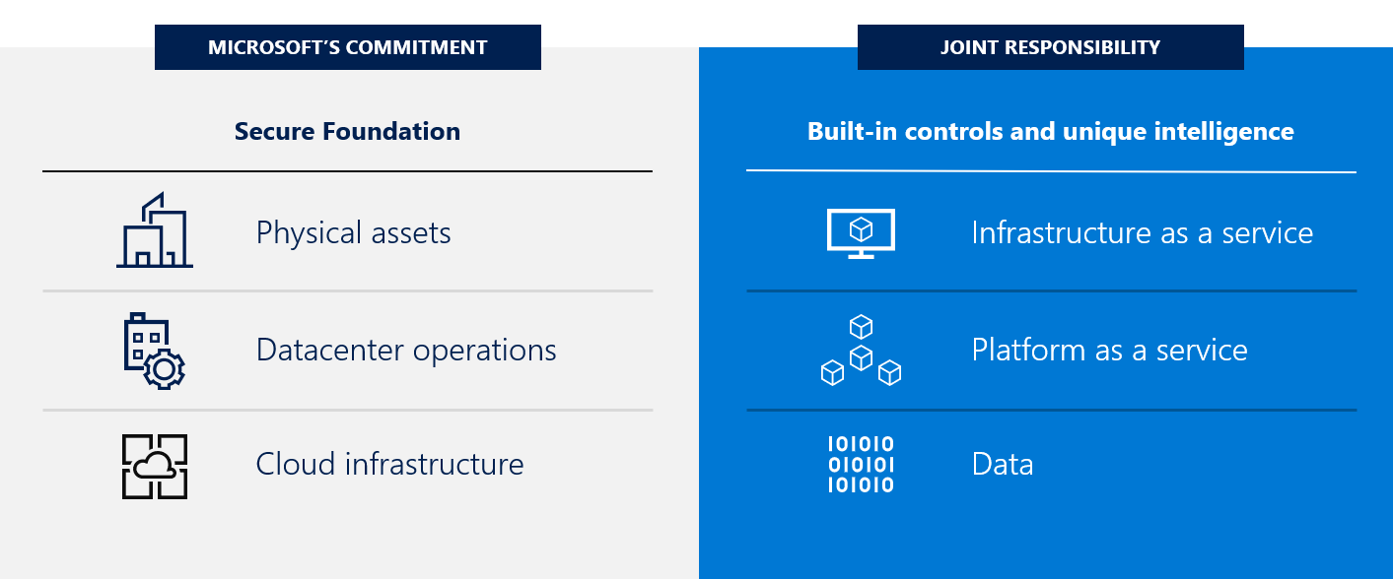
Cloud security is a shared responsibility
Shared responsibility model for cloud security

Slide 8
Responsibility zones
Customer
Microsoft
Data governance & rights management
Client endpoints
Account access & management
Identity & directory infrastructure
Application
Network controls
Virtual Operating System
Physical hosts
Physical network
Physical datacenter
On-prem
IaaS
PaaS
SaaS
Always retained by customer
Varies by service type
Transfers to Microsoft

Slide 9
Strengthen security posture
Continuously assess security state
Optimize and improve security by configuring recommended controls
Azure Security Center
Manage organizational security policy and compliance

Slide 10




Securing Compute workloads
What are ‘Compute’ resources?
Virtual machines
Containers
Azure functions
Web apps
Data governance & rights management
Client endpoints
Account access & management
Identity & directory infrastructure
Application
Network controls
Virtual Operating System
IaaS
File Integrity Monitoring, Data classification, Encrypted @ rest
Not in scope for Security Center (use WDATP)
MFA and Access hygiene recommendations
Identity recommendations, integration with AAD Identity protection
>>Not covered by Security Center<<
NSG active & configured, WAF & NGFW, Network map, !SSL usage
DATP for Servers, EPP, Updates, config checks, JIT VM access, AAC

Slide 11
Protect against threats
Detect and block advanced malware and threats for servers
Detect threats across IaaS and PaaS services using advanced analytics
Reduce exposure to brute force attacks
Azure Security Center
Protect data services against malicious attacks

Slide 12
Creating Custom Security Alerts

Slide 13
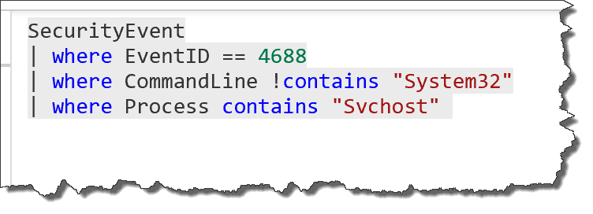
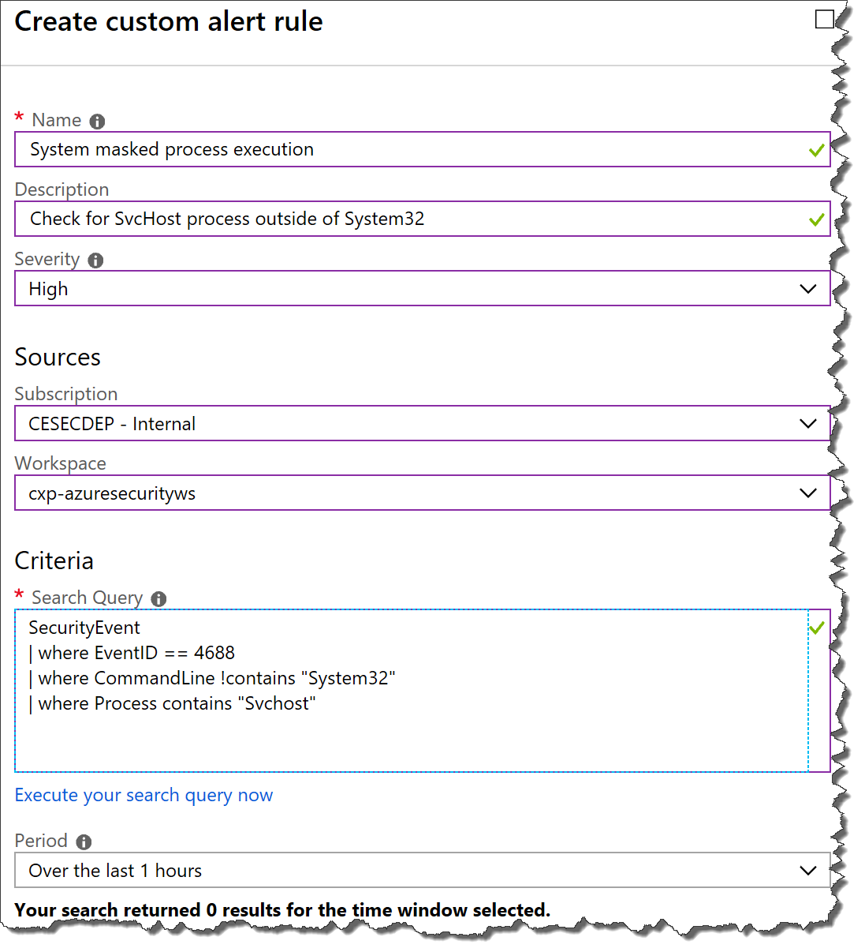


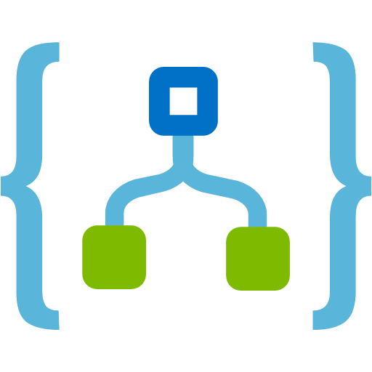
What is a custom alert?
A ‘Breadth’ check for indicators of compromise
1. Log Analytics query over Security Center-collected data
2. Save query as a Security Center Custom Alert
3. Build automation workflows when the alert fires

Slide 14







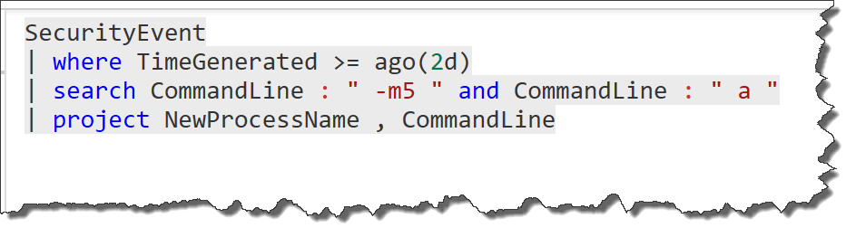
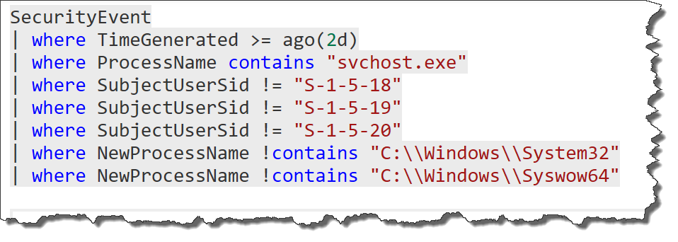
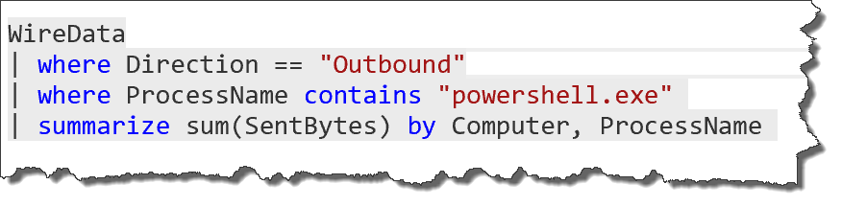
Custom alert example
Data ex-filtration example: “Alert me when compression software is used in suspicious ways”
Attack approaches:
Masking commands used with WinRAR
Spoofing System file names with other executables
Brute force alert
Compromised credentials
Anomalous activity
WinRar use
Wiredata suspicious traffic
Incorrect SID
!Win32 SvcHost use
Suspicious temp activity

Slide 15
Demo – Attack simulation & creating custom alerts

Slide 16
Get secure faster
Automatically discover and onboard Azure resources
Extend to server workloads running in other clouds and on-premises datacenter
Azure Security Center
Integrate with existing workflows and tools (SIEM, NG Firewall..)

Slide 17
Securing Azure Subscriptions at Scale

Slide 18
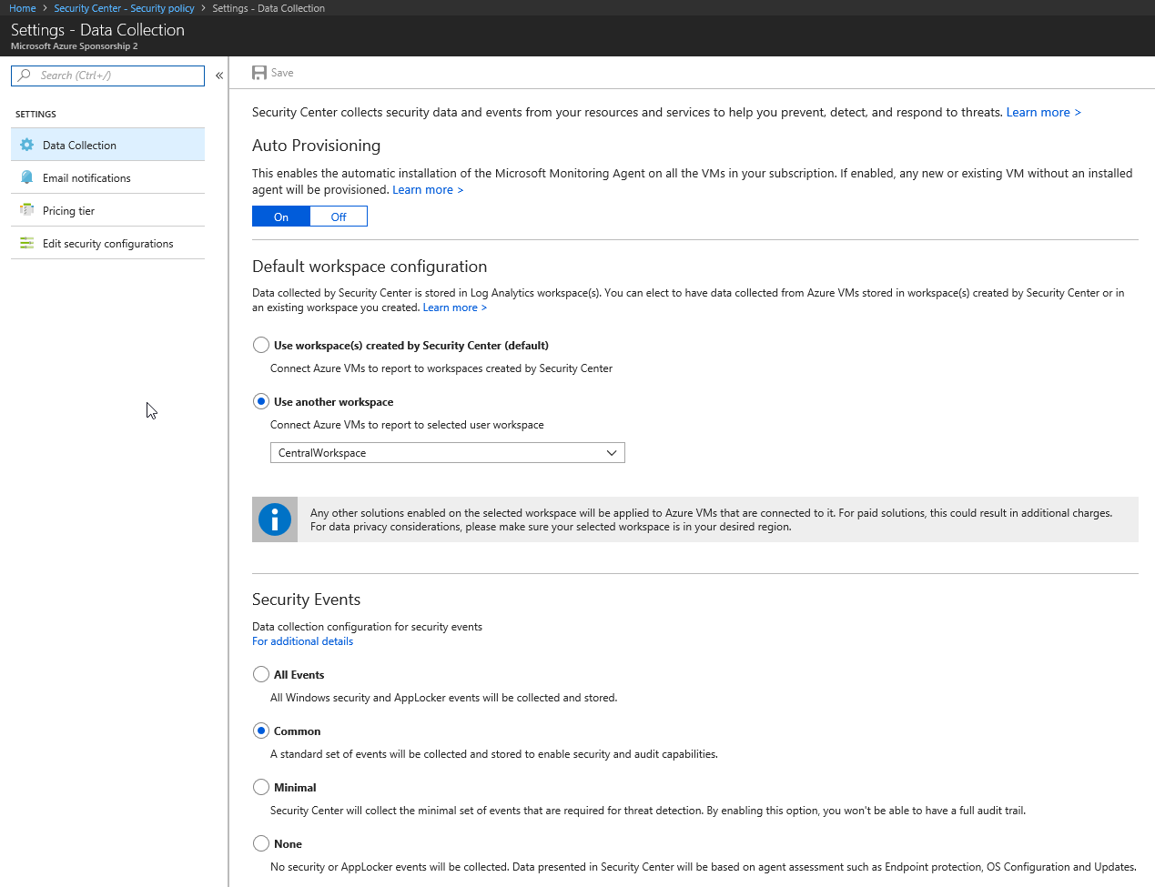
Configure Data Collection
Provisioning
Workspace
Events

Slide 19
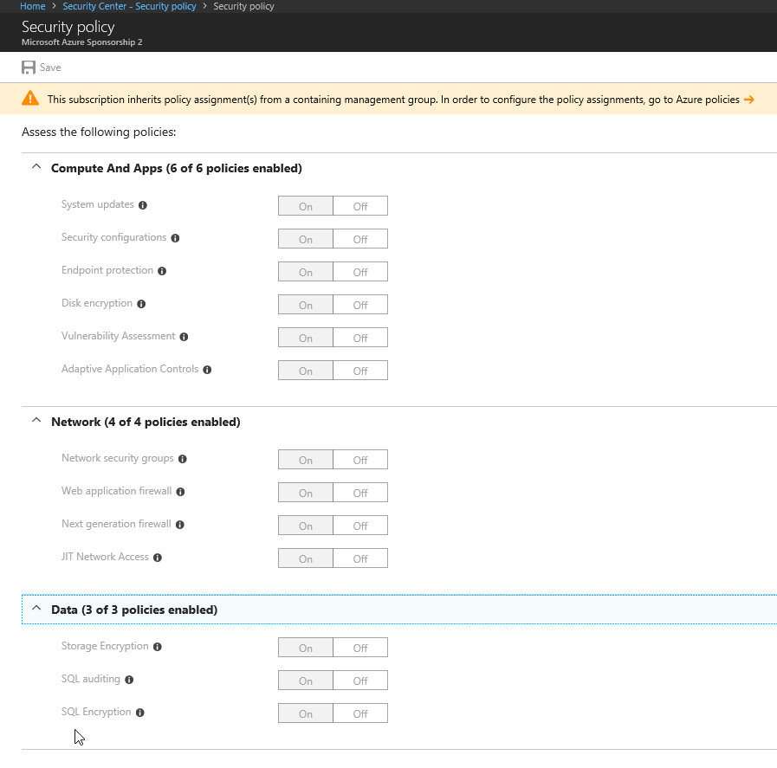
Configure Policy
Policy per subscription

Slide 20
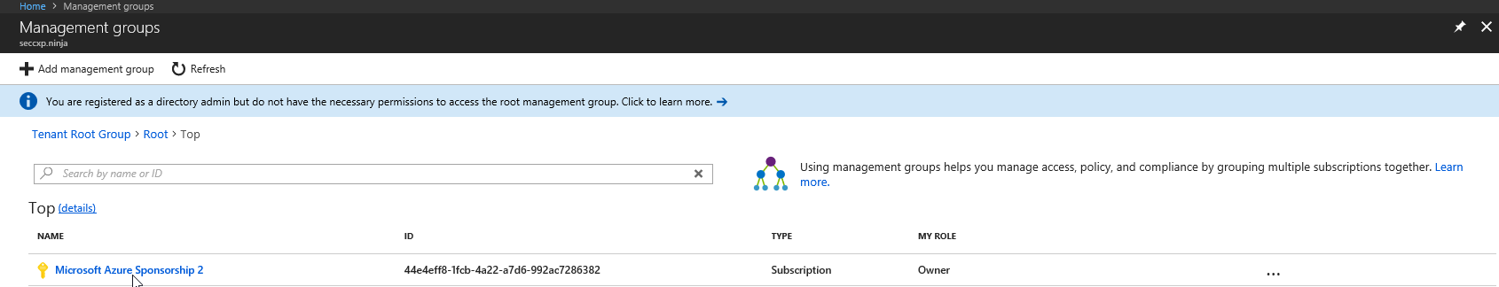
Configure Policy
Policy per subscription
Azure Management Groups

Slide 21
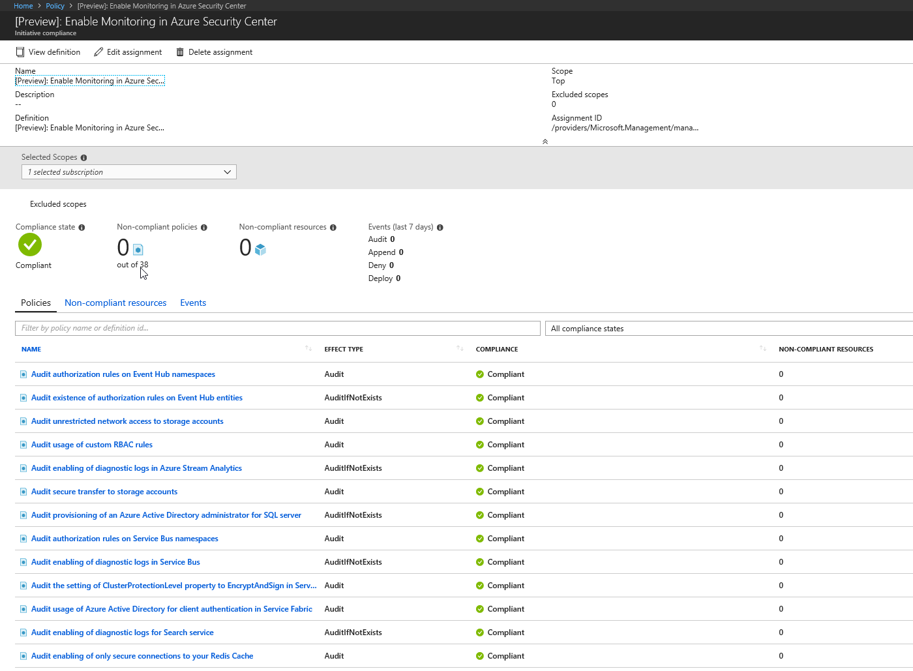
Configure Policy
Policy per subscription
Azure Management Groups
Azure Policy

Slide 22
Demo – Set Policy using Management Group
Nicholas

Slide 23
PowerShell
Get-AzureRmSubscription | foreach{Set-AzureRmSecurityAutoProvisioningSetting -Name default}
Get-AzureRmSubscription | foreach{Set-AzureRmSecurityContact -Name "default" -Email “blah@blah.com" -Phone “123-456-7890" -AlertAdmin –NotifyOnAlert}
Get-AzureRmSubscription | foreach{Set-AzureRmSecurityAutoPricingTier -Name default –PricingTier Standard}
Get-AzureRmSubscription | foreach{
$subid = $_.Id
Set-AzureRmSecurityWorkspaceSetting -Name default -Scope "/subscriptions/$subid" -WorkspaceId "/subscriptions/<subscriptionid>/resourcegroups/<rgname>/providers/microsoft.operationalinsights/workspaces/<workspacename>"
}

Slide 24
PowerShell
Get-AzureRmSubscription | foreach{
Set-AzureRmSecurityAutoProvisioningSetting -Name default
Set-AzureRmSecurityContact -Name "default" -Email “blah@blah.com" -Phone “123-456-7890" -AlertAdmin –NotifyOnAlert
Set-AzureRmSecurityAutoPricingTier -Name default –PricingTier Standard
$subid = $_.Id
Set-AzureRmSecurityWorkspaceSetting -Name default -Scope "/subscriptions/$subid" -WorkspaceId "/subscriptions/<subscriptionid>/resourcegroups/<rgname>/providers/microsoft.operationalinsights/workspaces/<workspacename>"
}

Slide 25
ARM
https://github.com/tianderturpijn/ASC/blob/master/ARM/configureASCnewAPI.json
{
"$schema": "https://schema.management.azure.com/schemas/2015-01-01/deploymentTemplate.json#",
"contentVersion": "1.0.0.0",
"parameters": {
"autoProvisioning":{
"type": "string",
"allowedValues": [
"On",
"Off"
],
"metadata": {
"description": "Turn automatic deployment by ASC of the MMA (OMS VM extension) on or off"
}
},
"workspaceName": {
"type": "string",
"metadata": {
"description": "Specify the name of your custom Log Analytics workspace to collect ASC data."
}
},
"workspaceSubscriptionId": {
"type": "string",
"metadata": {
"description": "Specify the subscriptionId where the custom Log Analytics workspace is deployed."
}
},
"workspaceResourceGroup": {
"type": "string",
"metadata": {
"description": "Specify the resource group where the custom Log Analytics workspace is deployed."
}
},
"emailSecurityContact":{
"type": "string",
"metadata": {
"description": "email address of the contact, in the form of john@doe.com"
}
},
"phoneSecurityContact":{
"type": "string",
"metadata": {
"description": "phone number of the Security Contact"
}
},
"alertNotifications":{
"type": "string",
"allowedValues": [
"On",
"Off"
],
"metadata": {
"description": "Send alert notifications to Security Contact"
}
},
"alertsToAdmin":{
"type": "string",
"allowedValues": [
"On",
"Off"
],
"metadata": {
"description": "Send alert notifications to Admins"
}
},
"securitySettings": {
"type": "string",
"allowedValues": [
"On",
"Off"
],
"metadata": {
"description": "Turn security policy settings On or Off."
}
}
},
"variables": {},
"resources": [
{
"type": "Microsoft.Security/autoProvisioningSettings",
"name": "default",
"apiVersion": "2017-08-01-preview",
"properties":{
"autoProvision": "[parameters('autoProvisioning')]"
}
},
{
"type": "Microsoft.Security/workspaceSettings",
"apiVersion": "2017-08-01-preview",
"name": "default",
"properties": {
"workspaceId": "[concat('/subscriptions/', parameters('workspaceSubscriptionId'), '/resourceGroups/', parameters('workspaceResourceGroup'), '/providers/Microsoft.OperationalInsights/workspaces/', parameters('workspaceName'))]",
"scope": "[subscription().id]"
}
},
{
"type": "Microsoft.Security/securityContacts",
"name": "default1",
"apiVersion": "2017-08-01-preview",
"properties":{
"email": "[parameters('emailSecurityContact')]",
"phone": "[parameters('phoneSecurityContact')]",
"alertNotifications": "[parameters('alertNotifications')]",
"alertsToAdmins": "[parameters('alertsToAdmin')]"
}
},
{
"type": "Microsoft.Security/policies",
"apiVersion": "2015-06-01-preview",
"name": "default",
"properties": {
"policyLevel": "Subscription",
"name": "default",
"unique": "Off",
"logCollection": "Off",
"recommendations": {
"patch": "[parameters('securitySettings')]",
"baseline": "[parameters('securitySettings')]",
"antimalware": "[parameters('securitySettings')]",
"diskEncryption": "[parameters('securitySettings')]",
"acls": "[parameters('securitySettings')]",
"nsgs": "[parameters('securitySettings')]",
"waf": "[parameters('securitySettings')]",
"sqlAuditing": "[parameters('securitySettings')]",
"sqlTde": "[parameters('securitySettings')]",
"ngfw": "[parameters('securitySettings')]",
"vulnerabilityAssessment": "[parameters('securitySettings')]",
"storageEncryption": "[parameters('securitySettings')]",
"jitNetworkAccess": "[parameters('securitySettings')]"
},
"pricingConfiguration": {
"selectedPricingTier": "Standard"
}
}
}
],
"outputs": {}
}
{
"$schema": "https://schema.management.azure.com/schemas/2015-01-01/deploymentTemplate.json#",
"contentVersion": "1.0.0.0",
"parameters": {
"autoProvisioning":{
"type": "string",
"allowedValues": [
"On",
"Off"
],
"metadata": {
"description": "Turn automatic deployment by ASC of the MMA (OMS VM extension) on or off"
}
},
"workspaceName": {
"type": "string",
"metadata": {
"description": "Specify the name of your custom Log Analytics workspace to collect ASC data."
}
},
"workspaceSubscriptionId": {
"type": "string",
"metadata": {
"description": "Specify the subscriptionId where the custom Log Analytics workspace is deployed."
}
},
"workspaceResourceGroup": {
"type": "string",
"metadata": {
"description": "Specify the resource group where the custom Log Analytics workspace is deployed."
}
},
"emailSecurityContact":{
"type": "string",
"metadata": {
"description": "email address of the contact, in the form of john@doe.com"
}
},
"phoneSecurityContact":{
"type": "string",
"metadata": {
"description": "phone number of the Security Contact"
}
},
"alertNotifications":{
"type": "string",
"allowedValues": [
"On",
"Off"
],
"metadata": {
"description": "Send alert notifications to Security Contact"
}
},
"alertsToAdmin":{
"type": "string",
"allowedValues": [
"On",
"Off"
],
"metadata": {
"description": "Send alert notifications to Admins"
}
},
"securitySettings": {
"type": "string",
"allowedValues": [
"On",
"Off"
],
"metadata": {
"description": "Turn security policy settings On or Off."
}
}
},
"variables": {},
"resources": [
{
"type": "Microsoft.Security/autoProvisioningSettings",
"name": "default",
"apiVersion": "2017-08-01-preview",
"properties":{
"autoProvision": "[parameters('autoProvisioning')]"
}
},
{
"type": "Microsoft.Security/workspaceSettings",
"apiVersion": "2017-08-01-preview",
"name": "default",
"properties": {
"workspaceId": "[concat('/subscriptions/', parameters('workspaceSubscriptionId'), '/resourceGroups/', parameters('workspaceResourceGroup'), '/providers/Microsoft.OperationalInsights/workspaces/', parameters('workspaceName'))]",
"scope": "[subscription().id]"
}
},
{
"type": "Microsoft.Security/securityContacts",
"name": "default1",
"apiVersion": "2017-08-01-preview",
"properties":{
"email": "[parameters('emailSecurityContact')]",
"phone": "[parameters('phoneSecurityContact')]",
"alertNotifications": "[parameters('alertNotifications')]",
"alertsToAdmins": "[parameters('alertsToAdmin')]"
}
},
{
"type": "Microsoft.Security/policies",
"apiVersion": "2015-06-01-preview",
"name": "default",
"properties": {
"policyLevel": "Subscription",
"name": "default",
"unique": "Off",
"logCollection": "Off",
"recommendations": {
"patch": "[parameters('securitySettings')]",
"baseline": "[parameters('securitySettings')]",
"antimalware": "[parameters('securitySettings')]",
"diskEncryption": "[parameters('securitySettings')]",
"acls": "[parameters('securitySettings')]",
"nsgs": "[parameters('securitySettings')]",
"waf": "[parameters('securitySettings')]",
"sqlAuditing": "[parameters('securitySettings')]",
"sqlTde": "[parameters('securitySettings')]",
"ngfw": "[parameters('securitySettings')]",
"vulnerabilityAssessment": "[parameters('securitySettings')]",
"storageEncryption": "[parameters('securitySettings')]",
"jitNetworkAccess": "[parameters('securitySettings')]"
},
"pricingConfiguration": {
"selectedPricingTier": "Standard"
}
}
}
],
"outputs": {}
}

Slide 26
PowerShell – Management Groups and Policy
$root = Get-AzureRmManagementGroup -GroupName root
New-AzureRmManagementGroup -GroupName BusApps -DisplayName "Business Applications" -ParentId $root.Id
Get-AzureRmSubscription | New-AzureRmManagementGroupSubscription -GroupName BusApps

Slide 27
PowerShell – Management Groups and Policy
$MG = Get-AzureRmManagementGroup -GroupName BusApps
$Settings = @{
"systemUpdatesMonitoringEffect" = "AuditIfNotExists"
"systemConfigurationsMonitoringEffect" = "AuditIfNotExists"
"endpointProtectionMonitoringEffect" = "AuditIfNotExists"
"diskEncryptionMonitoringEffect" = "AuditIfNotExists"
"networkSecurityGroupsMonitoringEffect" = "AuditIfNotExists"
"webApplicationFirewallMonitoringEffect" = "AuditIfNotExists"
"nextGenerationFirewallMonitoringEffect" = "AuditIfNotExists"
"vulnerabilityAssesmentMonitoringEffect" = "AuditIfNotExists"
"storageEncryptionMonitoringEffect" = "Audit"
"jitNetworkAccessMonitoringEffect" = "AuditIfNotExists"
"adaptiveApplicationControlsMonitoringEffect" = "AuditIfNotExists"
"sqlAuditingMonitoringEffect" = "AuditIfNotExists"
"sqlEncryptionMonitoringEffect" = "AuditIfNotExists"
"diagnosticsLogsInAppServiceMonitoringEffect" = "Audit"
"encryptionOfAutomationAccountMonitoringEffect" = "Audit"
"diagnosticsLogsInBatchAccountMonitoringEffect" = "AuditIfNotExists"
"diagnosticsLogsInBatchAccountRetentionDays" = "365"
"metricAlertsInBatchAccountMonitoringEffect" = "AuditIfNotExists"
"classicComputeVMsMonitoringEffect" = "Audit"
"classicStorageAccountsMonitoringEffect" = "Audit"
"diagnosticsLogsInDataLakeAnalyticsMonitoringEffect" = "AuditIfNotExists"
"diagnosticsLogsInDataLakeAnalyticsRetentionDays" = "Audit"
"diagnosticsLogsInDataLakeStoreMonitoringEffect" = "AuditIfNotExists"
"diagnosticsLogsInDataLakeStoreRetentionDays" = "Audit"
"diagnosticsLogsInEventHubMonitoringEffect" = "AuditIfNotExists"
"diagnosticsLogsInEventHubRetentionDays" = "Audit"
"diagnosticsLogsInKeyVaultMonitoringEffect" = "AuditIfNotExists"
"diagnosticsLogsInKeyVaultRetentionDays" = "365"
"diagnosticsLogsInLogicAppsMonitoringEffect" = "AuditIfNotExists"
"diagnosticsLogsInLogicAppsRetentionDays" = "365"
"diagnosticsLogsInRedisCacheMonitoringEffect" = "Audit"
"diagnosticsLogsInSearchServiceMonitoringEffect" = "AuditIfNotExists"
"diagnosticsLogsInSearchServiceRetentionDays" = "365"
"aadAuthenticationInServiceFabricMonitoringEffect" = "Audit"
"clusterProtectionLevelInServiceFabricMonitoringEffect" = "Audit"
"diagnosticsLogsInServiceBusMonitoringEffect" = "AuditIfNotExists"
"diagnosticsLogsInServiceBusRetentionDays" = "365"
"namespaceAuthorizationRulesInServiceBusMonitoringEffect" = "Audit"
"aadAuthenticationInSqlServerMonitoringEffect" = "AuditIfNotExists"
"secureTransferToStorageAccountMonitoringEffect" = "Audit"
"diagnosticsLogsInStreamAnalyticsMonitoringEffect" = "AuditIfNotExists"
"diagnosticsLogsInStreamAnalyticsRetentionDays" = "365"
"useRbacRulesMonitoringEffect" = "Audit"
"disableUnrestrictedNetworkToStorageAccountMonitoringEffect" = "Audit"
"diagnosticsLogsInServiceFabricMonitoringEffect" = "AuditIfNotExists"
"accessRulesInEventHubNamespaceMonitoringEffect" = "Audit"
"accessRulesInEventHubMonitoringEffect" = "AuditIfNotExists"
"sqlDbVulnerabilityAssesmentMonitoringEffect" = "AuditIfNotExists"
"identityDesignateLessThanOwnersMonitoringEffect" = "AuditIfNotExists"
"identityDesignateMoreThanOneOwnerMonitoringEffect" = "AuditIfNotExists"
"identityEnableMFAForOwnerPermissionsMonitoringEffect" = "AuditIfNotExists"
"identityEnableMFAForWritePermissionsMonitoringEffect" = "AuditIfNotExists"
"identityEnableMFAForReadPermissionsMonitoringEffect" = "AuditIfNotExists"
"identityRemoveDeprecatedAccountWithOwnerPermissionsMonitoringEffect" = "AuditIfNotExists"
"identityRemoveDeprecatedAccountMonitoringEffect" = "AuditIfNotExists"
"identityRemoveExternalAccountWithOwnerPermissionsMonitoringEffect" = "AuditIfNotExists"
"identityRemoveExternalAccountWithWritePermissionsMonitoringEffect" = "AuditIfNotExists"
"identityRemoveExternalAccountWithReadPermissionsMonitoringEffect" = "AuditIfNotExists"
}
$ASCPolicy = Get-AzureRmPolicySetDefinition | where {$_.Properties.Displayname -eq "[Preview]: Enable Monitoring in Azure Security Center"}
New-AzureRmPolicyAssignment -Name "EnableASC" -DisplayName "Enable Azure Security Center" -Scope $MG.Id -PolicySetDefinition $ASCPolicy -PolicyParameterObject $Settings

Slide 28
PowerShell
$Settings = @{
"systemUpdatesMonitoringEffect" = "AuditIfNotExists"
"systemConfigurationsMonitoringEffect" = "AuditIfNotExists"
"endpointProtectionMonitoringEffect" = "AuditIfNotExists"
"diskEncryptionMonitoringEffect" = "AuditIfNotExists"
"networkSecurityGroupsMonitoringEffect" = "AuditIfNotExists"
"webApplicationFirewallMonitoringEffect" = "AuditIfNotExists"
"nextGenerationFirewallMonitoringEffect" = "AuditIfNotExists"
"vulnerabilityAssesmentMonitoringEffect" = "AuditIfNotExists"
"storageEncryptionMonitoringEffect" = "Audit"
"jitNetworkAccessMonitoringEffect" = "AuditIfNotExists"
"adaptiveApplicationControlsMonitoringEffect" = "AuditIfNotExists"
"sqlAuditingMonitoringEffect" = "AuditIfNotExists"
"sqlEncryptionMonitoringEffect" = "AuditIfNotExists"
"diagnosticsLogsInAppServiceMonitoringEffect" = "Audit"
"encryptionOfAutomationAccountMonitoringEffect" = "Audit"
"diagnosticsLogsInBatchAccountMonitoringEffect" = "AuditIfNotExists"
"diagnosticsLogsInBatchAccountRetentionDays" = "365"
"metricAlertsInBatchAccountMonitoringEffect" = "AuditIfNotExists"
"classicComputeVMsMonitoringEffect" = "Audit"
"classicStorageAccountsMonitoringEffect" = "Audit"
"diagnosticsLogsInDataLakeAnalyticsMonitoringEffect" = "AuditIfNotExists"
"diagnosticsLogsInDataLakeAnalyticsRetentionDays" = "Audit"
"diagnosticsLogsInDataLakeStoreMonitoringEffect" = "AuditIfNotExists"
"diagnosticsLogsInDataLakeStoreRetentionDays" = "Audit"
"diagnosticsLogsInEventHubMonitoringEffect" = "AuditIfNotExists"
"diagnosticsLogsInEventHubRetentionDays" = "Audit"
"diagnosticsLogsInKeyVaultMonitoringEffect" = "AuditIfNotExists"
"diagnosticsLogsInKeyVaultRetentionDays" = "365"
"diagnosticsLogsInLogicAppsMonitoringEffect" = "AuditIfNotExists"
"diagnosticsLogsInLogicAppsRetentionDays" = "365"
"diagnosticsLogsInRedisCacheMonitoringEffect" = "Audit"
"diagnosticsLogsInSearchServiceMonitoringEffect" = "AuditIfNotExists"
"diagnosticsLogsInSearchServiceRetentionDays" = "365"
"aadAuthenticationInServiceFabricMonitoringEffect" = "Audit"
"clusterProtectionLevelInServiceFabricMonitoringEffect" = "Audit"
"diagnosticsLogsInServiceBusMonitoringEffect" = "AuditIfNotExists"
"diagnosticsLogsInServiceBusRetentionDays" = "365"
"namespaceAuthorizationRulesInServiceBusMonitoringEffect" = "Audit"
"aadAuthenticationInSqlServerMonitoringEffect" = "AuditIfNotExists"
"secureTransferToStorageAccountMonitoringEffect" = "Audit"
"diagnosticsLogsInStreamAnalyticsMonitoringEffect" = "AuditIfNotExists"
"diagnosticsLogsInStreamAnalyticsRetentionDays" = "365"
"useRbacRulesMonitoringEffect" = "Audit"
"disableUnrestrictedNetworkToStorageAccountMonitoringEffect" = "Audit"
"diagnosticsLogsInServiceFabricMonitoringEffect" = "AuditIfNotExists"
"accessRulesInEventHubNamespaceMonitoringEffect" = "Audit"
"accessRulesInEventHubMonitoringEffect" = "AuditIfNotExists"
"sqlDbVulnerabilityAssesmentMonitoringEffect" = "AuditIfNotExists"
"identityDesignateLessThanOwnersMonitoringEffect" = "AuditIfNotExists"
"identityDesignateMoreThanOneOwnerMonitoringEffect" = "AuditIfNotExists"
"identityEnableMFAForOwnerPermissionsMonitoringEffect" = "AuditIfNotExists"
"identityEnableMFAForWritePermissionsMonitoringEffect" = "AuditIfNotExists"
"identityEnableMFAForReadPermissionsMonitoringEffect" = "AuditIfNotExists"
"identityRemoveDeprecatedAccountWithOwnerPermissionsMonitoringEffect" = "AuditIfNotExists"
"identityRemoveDeprecatedAccountMonitoringEffect" = "AuditIfNotExists"
"identityRemoveExternalAccountWithOwnerPermissionsMonitoringEffect" = "AuditIfNotExists"
"identityRemoveExternalAccountWithWritePermissionsMonitoringEffect" = "AuditIfNotExists"
"identityRemoveExternalAccountWithReadPermissionsMonitoringEffect" = "AuditIfNotExists"
}

Slide 29
Triggering automation from security alerts

Slide 30
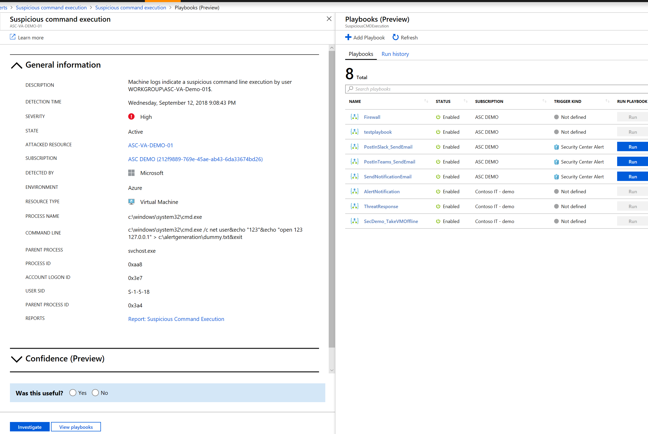
Automating Response
2 Options:
Logic Apps
Interactive

Slide 31
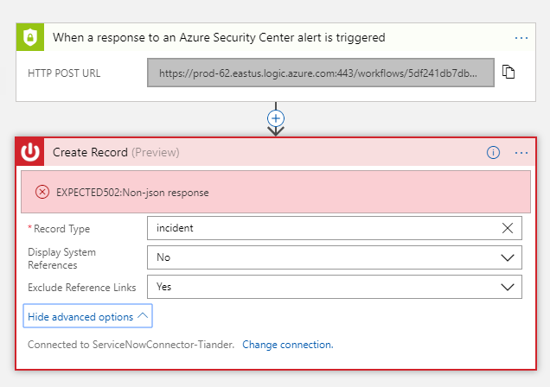
Automating Response
2 Options:
Logic Apps
Interactive

Slide 32
Automating Response
2 Options
Logic Apps
Interactive
Azure Monitor Alerts
Automatic

Slide 33
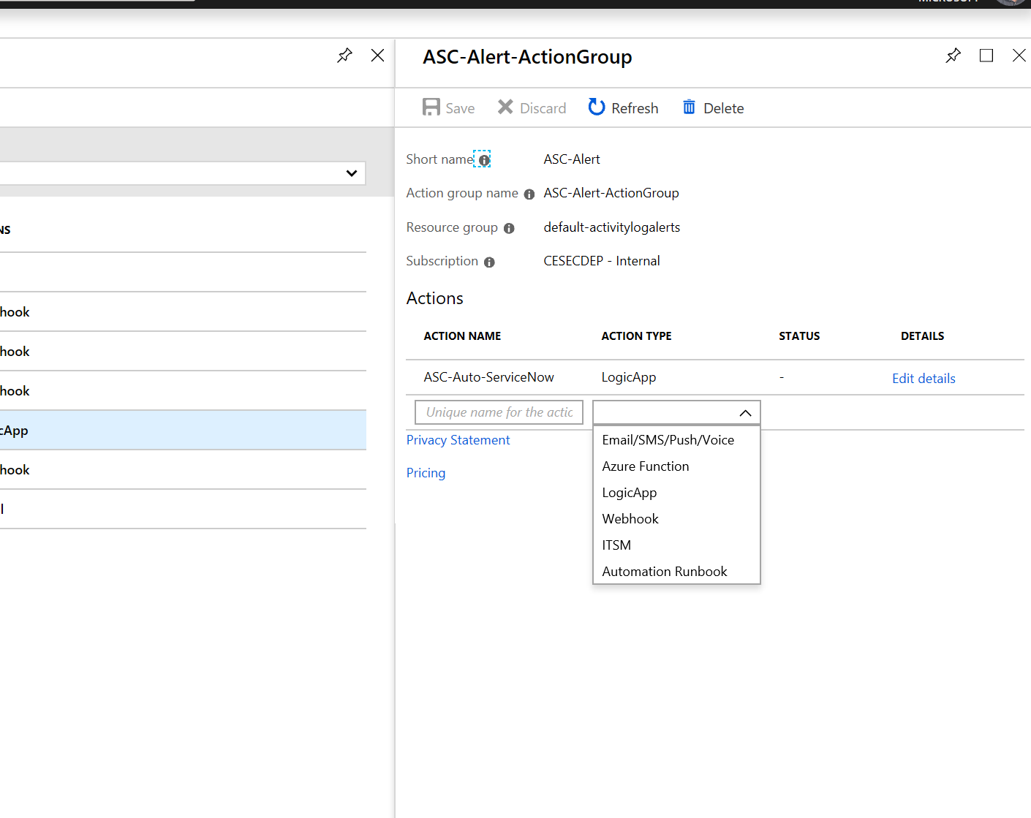
Automating Response
2 Options
Logic Apps
Interactive
Azure Monitor Alerts
Automatic

Slide 34
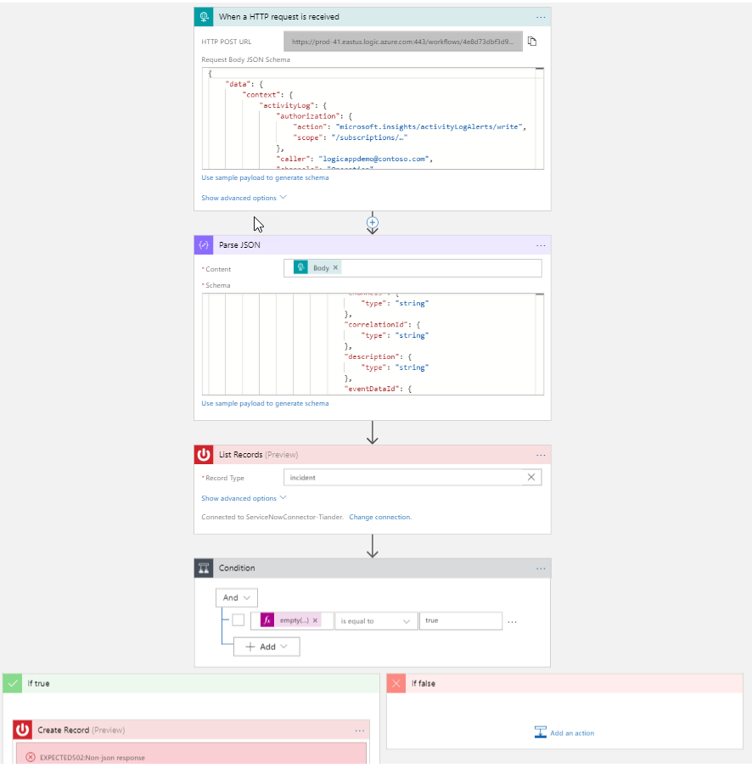
Automating Response
2 Options
Logic Apps
Interactive
Azure Monitor Alerts
Automatic

Slide 35
Closing

Slide 36
Resources
Resource | Link | Comment
Securing Azure reference | http://aka.ms/myasis | Definitive reference guide
Azure security best practices | https://azure.microsoft.com/resources/security-best-practices-for-azure-solutions/ | In-depth guidance for securing specific Azure workloads
Creating compliant workloads | https://servicetrust.microsoft.com/ViewPage/BlueprintOverview | FedRAMP, NIST SP800, FFIEC, and more
Getting started with Security Center | https://docs.microsoft.com/en-us/azure/security-center/security-center-get-started
Security playbook | ASCPlaybooks | Simulate & hunt threats, WAF playbooks & more
Azure templates for attack simulation | https://ASCPlaybooksSQLi https://ASCPlaybooksVAttack https://ASCPlaybooksXSS https://ASCPlaybooksDDos | SQL injection, Virus, cross-site scripting, and DDoS playbooks Credit: Avyan consulting
Security Center and Powershell samples | https://github.com/tianderturpijn/ASC | Common operations and ARM template

